Slide 1
HTML (Hyper Text Markup Language)
Introduction Part 2

Slide 2
HTML Attributes
HTML elements can have attributes
Attributes provide additional information about an element
Attributes are always specified in the start tag
Attributes come in name/value pairs like: name="value"

Slide 3
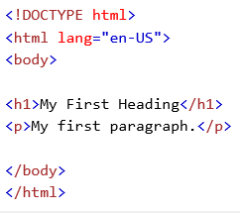
The lang Attribute
The document language can be declared in the <html> tag.
The language is declared in the lang attribute.
Declaring a language is important for accessibility applications (screen readers) and search engines:

Slide 4
The title Attribute
HTML paragraphs are defined with the <p> tag.
In this example, the <p> element has a title attribute. The value of the attribute is "About something":
When you move the mouse over the element, the title will be displayed as a tooltip.
<p title=“about something”>Occaecat reprehenderit sint magna mollit fugiat consequat nulla enim fugiat
exercitation qui. Exercitation sunt dolore sunt ullamco laboris nostrud
pariatur voluptate eu. Ullamco aute ut laboris ex mollit qui.</p>

Slide 5
The href Attribute
HTML links are defined with the <a> tag. The link address is specified in the href attribute:
<a href=“https//google.com”>this is a link.</a>

Slide 6
Size Attributes
HTML images are defined with the <img> tag.
The filename of the source (src), and the size of the image (width and height) are all provided as attributes:
The image size is specified in pixels: width="104" means 104 screen pixels wide.
<img src=“google.png” width=“100” height=“100”>

Slide 7
The alt Attribute
The alt attribute specifies an alternative text to be used, when an image cannot be displayed.
The value of the attribute can be read by screen readers. This way, someone "listening" to the webpage, e.g. a blind person, can "hear" the element.
<img src=“google.png” alt=“google png” width=“100” height=“100”>

Slide 8
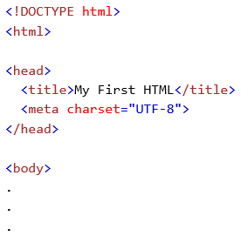
The HTML <head> Element
The HTML <head> element has nothing to do with HTML headings.
The HTML <head> element contains meta data. Meta data are not displayed.
The HTML <head> element is placed between the <html> tag and the <body> tag:

Slide 9
The HTML <title> Element
The HTML <title> element is meta data. It defines the HTML document's title.
The title will not be displayed in the document, but might be displayed in the browser tab.

Slide 10
The HTML Style Attribute
Setting the style of an HTML element, can be done with the style attribute.
The HTML style attribute has the following syntax:
style="property:value;"
The property is a CSS property. The value is a CSS value.

Slide 11
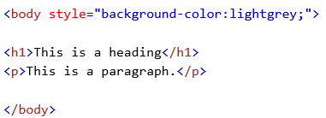
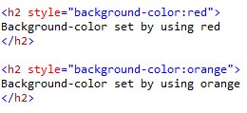
HTML Background Color
The background-color property defines the background color for an HTML element:
This example sets the background for a page to lightgrey:

Slide 12

HTML Text Color
The color property defines the text color for an HTML element:

Slide 13
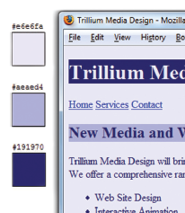
Making Color Choices
How to choose a color scheme?
Monochromatic
http://meyerweb.com/eric/tools/color-blend
Choose from a photograph or other image
http://www.colr.org
Begin with a favorite color
Use one of the sites below to choose other colors
http://colorsontheweb.com/colorwizard.asp
https://color.adobe.com/create/color-wheel
http://paletton.com

Slide 14
Support Web Accessibility Verify Sufficient Contrast
When you choose colors for text and background, sufficient contrast is needed so that the text is easy to read.
Use one of the following online tools to verify contrast:
http://webaim.org/resources/contrastchecker
http://snook.ca/technical/colour_contrast/colour.html
http://juicystudio.com/services/luminositycontrastratio.php

Slide 15

HTML Fonts
The font-family property defines the font to be used for an HTML element:

Slide 16

HTML Text Size
The font-size property defines the text size for an HTML element:

Slide 17

HTML Text Alignment
The text-align property defines the horizontal text alignment for an HTML element:

Slide 18
HTML <abbr> for Abbreviations
The HTML <abbr> element defines an abbreviation or an acronym.
Marking abbreviations can give useful information to browsers, translation systems and search-engines.

Slide 19
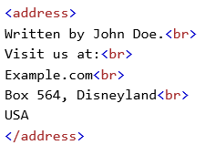
HTML <address> for Contact Information
The HTML <address> element defines contact information (author/owner) of a document or article.
The <address> element is usually displayed in italic. Most browsers will add a line break before and after the element.

Slide 20
HTML Comment Tags
You can add comments to your HTML source by using the following syntax:
<!-- Write your comments here -->
Comments are not displayed by the browser, but they can help document your HTML.
With comments you can place notifications and reminders in your HTML:

Slide 21
HTML Links - The target Attribute
The target attribute specifies where to open the linked document.
This example will open the linked document in a new browser window or in a new tab:
<a href=“https//google.com” target=“_blank”>this is a link.</a>

Slide 22
HTML Links - Colors
When you move the mouse over a link, two things will normally happen:
The mouse arrow will turn into a little hand
The color of the link element will change
By default, a link will appear like this (in all browsers):
An unvisited link is underlined and blue
A visited link is underlined and purple
An active link is underlined and red
You can change the default colors, by using styles:

Slide 23
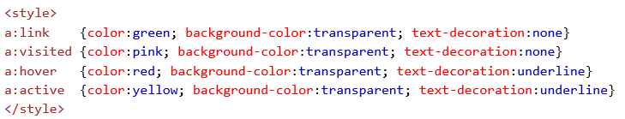
Example

Slide 24
HTML Links - Image as Link
It is common to use images as links:
Example:
<a href=“http://www.google.com”>
<img src=“cs_logo.png">
</a>

Slide 25
HTML Links - Create a Bookmark
HTML bookmarks are used to allow readers to jump to specific parts of a Web page.
Bookmarks are practical if your website has long pages.
To make a bookmark, you must first create the bookmark, and then add a link to it.
When the link is clicked, the page will scroll to the location with the bookmark.

Slide 26
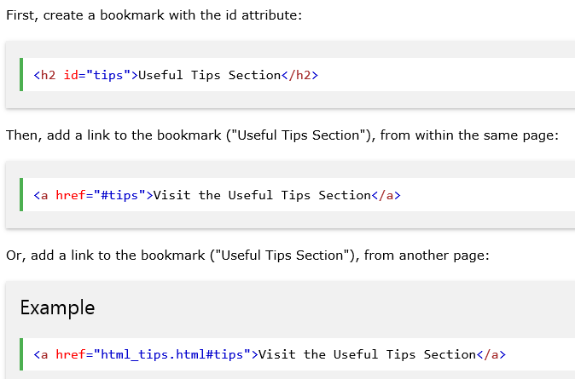
Example

Slide 27
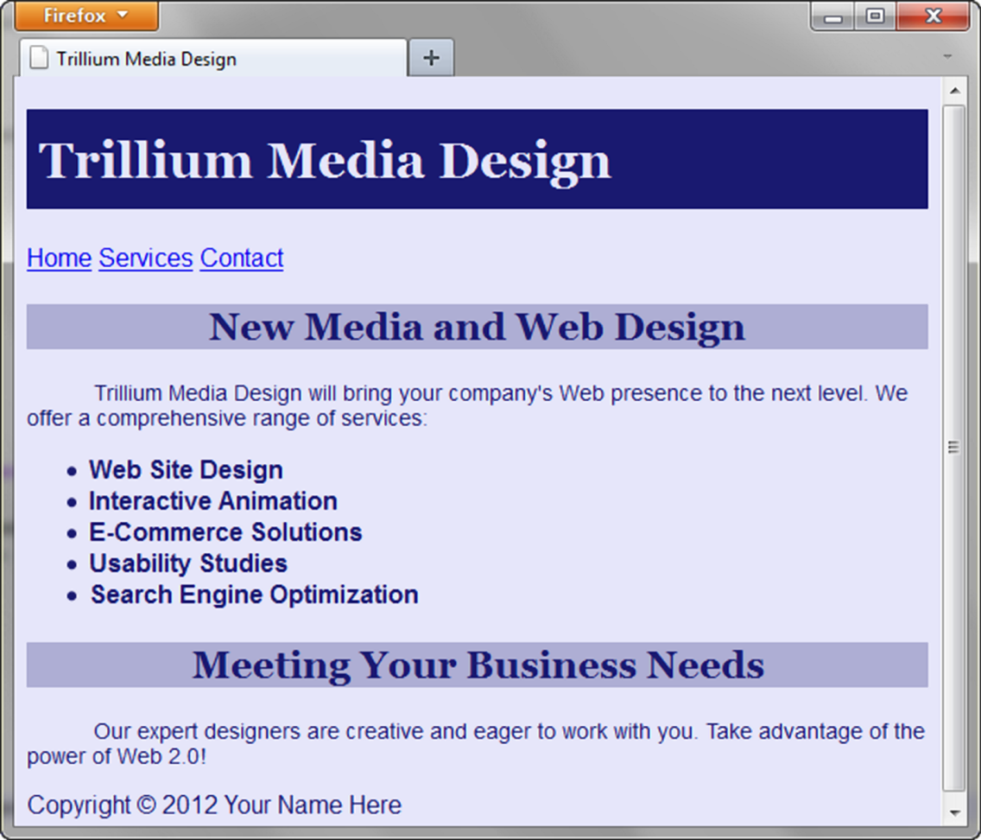
Embedded Styles Example
<style>
body { background-color: #E6E6FA;
color: #191970;
font-family: Arial, Verdana, sans-serif; }
h1 { background-color: #191970;
color: #E6E6FA;
line-height: 200%;
font-family: Georgia, "Times New Roman", serif; }
h2 { background-color: #AEAED4;
color: #191970; text-align: center;
font-family: Georgia, "Times New Roman", serif; }
p {font-size: .90em; text-indent: 3em; }
ul {font-weight: bold; }
</style>

Slide 28
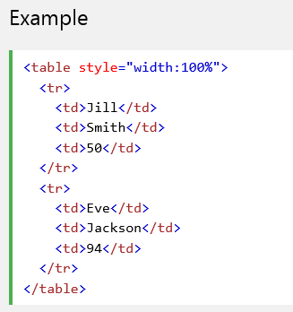
HTML Tables
Tables are defined with the <table> tag.
Tables are divided into table rows with the <tr> tag.
Table rows are divided into table data with the <td> tag.
A table row can also be divided into table headings with the <th> tag.

Slide 29
CSS Selectors
CSS style rules can be configured for an:
HTML element selector
class selector
id selector
descendant selector

Slide 30
More CSS TEXT Properties
line-height
Configures the height of the line of text (use the value 200% to appear double-spaced)
text-align
Configures alignment of text within a block display element
text-indent
Configures the indentation of the first line of text
text-decoration
Modifies the appearance of text with an underline, overline, or line-through
text-transform
Configures the capitalization of text
letter-spacing
Configures space between text characters
word-spacing
Configures space between words
text-shadow
Configures a drop shadow on text

Slide 31
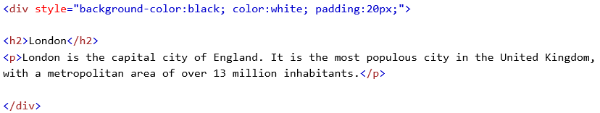
The <div> Element
The <div> element is a block-level element that is often used as a container for other HTML elements.
The <div> element has no required attributes, but style and class are common.

Slide 32
HTML The class Attribute
The class attribute specifies one or more class names for an HTML element.
The class name can be used by CSS and JavaScript to perform certain tasks for elements with the specified class name.
In CSS, to select elements with a specific class, write a period (.) character, followed by the name of the class:

Slide 33
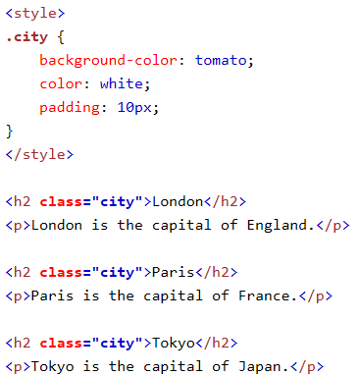
Example

Slide 34
HTML The id Attribute
The id attribute specifies a unique id for an HTML element (the value must be unique within the HTML document).
The id value can be used by CSS and JavaScript to perform certain tasks for a unique element with the specified id value.
In CSS, to select an element with a specific id, write a hash (#) character, followed by the id of the element:

Slide 35
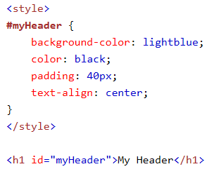
Example

Slide 36
Classing Block Elements
The HTML class attribute makes it possible to define equal styles for "equal" < div> elements:

Slide 37
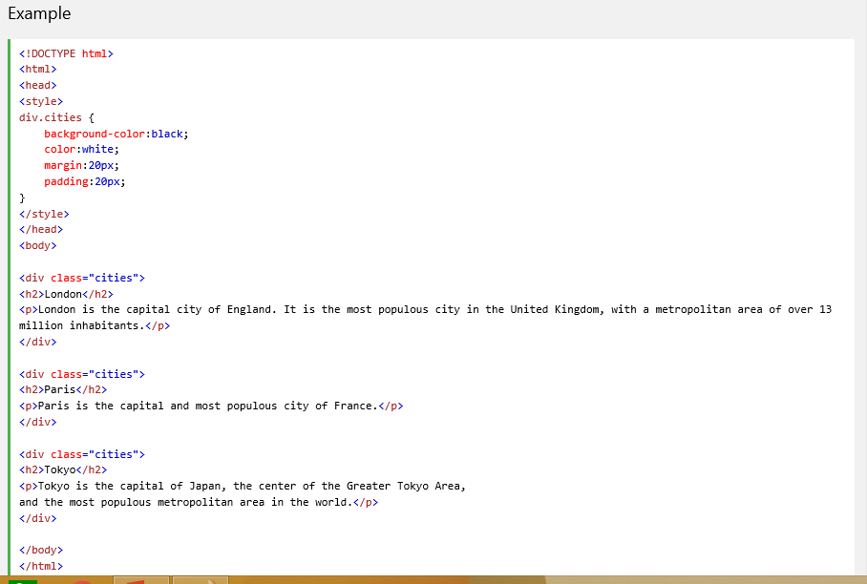

Slide 38
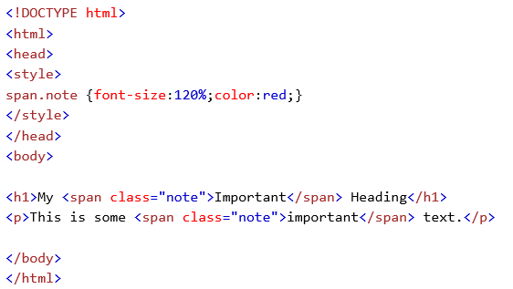
Classing Inline Elements
The HTML class attribute also makes it possible to define equal styles for "equal" <span> elements:

Slide 39
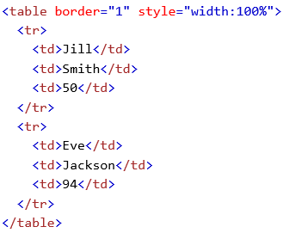
An HTML Table with a Border Attribute
If you do not specify a border for the table, it will be displayed without borders.
A border can be added using the border attribute:

Slide 40
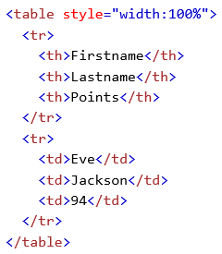
HTML Table Headings
Table headings are defined with the <th> tag.
By default, all major browsers display table headings as bold and centered:

Slide 41
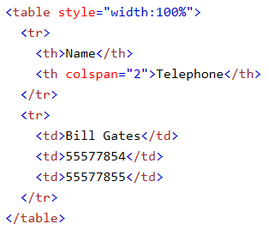
HTML Table - Cells that Span Many Columns
To make a cell span more than one column, use the colspan attribute:

Slide 42
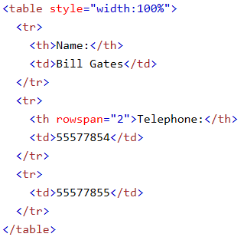
HTML Table - Cells that Span Many Rows
To make a cell span more than one row, use the rowspan attribute:

Slide 43
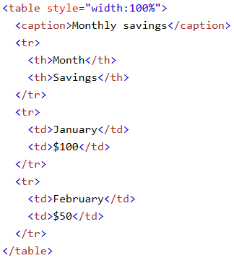
HTML Table - Adding a Caption
To add a caption to a table, use the <caption> tag:

Slide 44
HTML Iframes
An iframe is used to display a web page within a web page.
The syntax for adding an iframe is:
<iframe src="URL"></iframe>
The src attribute specifies the URL (web address) of the iframe page.

Slide 45
Iframe - Set Height and Width
Use the height and width attributes to specify the size.
The attribute values are specified in pixels by default, but they can also be in percent (like "80%").

Slide 46
Iframe - Remove the Border
By default, an iframe has a black border around it.
To remove the border, add the style attribute and use the CSS border property:

Slide 47
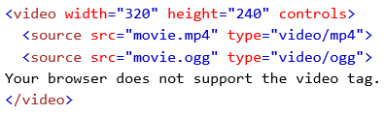
The HTML <video> Element
To show a video in HTML, use the <video> element:
<video src="test.mp4" width="320" height="240" control> </video>

Slide 48
How it Works
The controls attribute adds video controls, like play, pause, and volume.
It is a good idea to always include width and height attributes.
If height and width are not set, the browser does not know the size of the video. The effect will be that the page will change (or flicker) while the video loads.
Text between the <video> and </video> tags will only display in browsers that do not support the <video> element.
Multiple <source> elements can link to different video files. The browser will use the first recognized format.

Slide 49
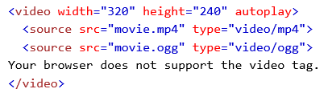
HTML <video> Autoplay
To start a video automatically use the autoplay attribute:
<video src=“test.mov" width="320" height="240" control> </video>

Slide 50
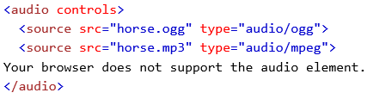
The HTML <audio> Element
To play an audio file in HTML, use the <audio> element:

